Slide 1
ACCIDENTALIDAD 2025 MADRID
Grupo 13
Elena de Arriba Jaro
Julián Alberto Villafuerte Zevallos
Laura Granero Martín
Tania Mobasser Aslfakouri
Gonzalo Sanz Pérez

Slide 2
TABLE OF CONTENTS
METHODOLOGY
CSV SELECTED
URIS
ONTOLOGY
RECONCILED CSV
MAPPINGS
RDF
APP

Slide 3
METHODOLOGY
CSV selection
URI selection
Ontology drawing in Drawio
Ontology creation using CHOWLK
Instance creation with Protégé
Data set cleaning with OpenRefine
Data set reconciliation
Mapping creation
Obtaining RDF through Morph KGC

Slide 4
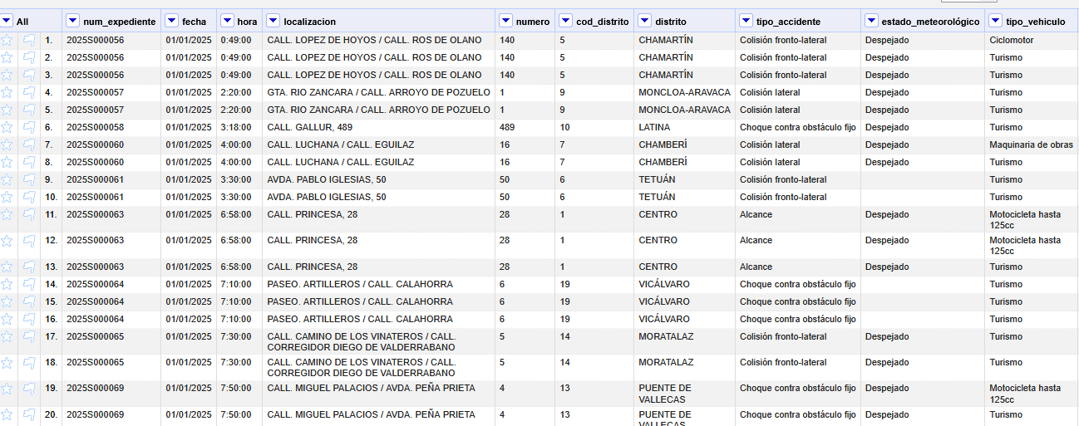
CSV SELECTED
2025 Accidentalidad

Slide 5
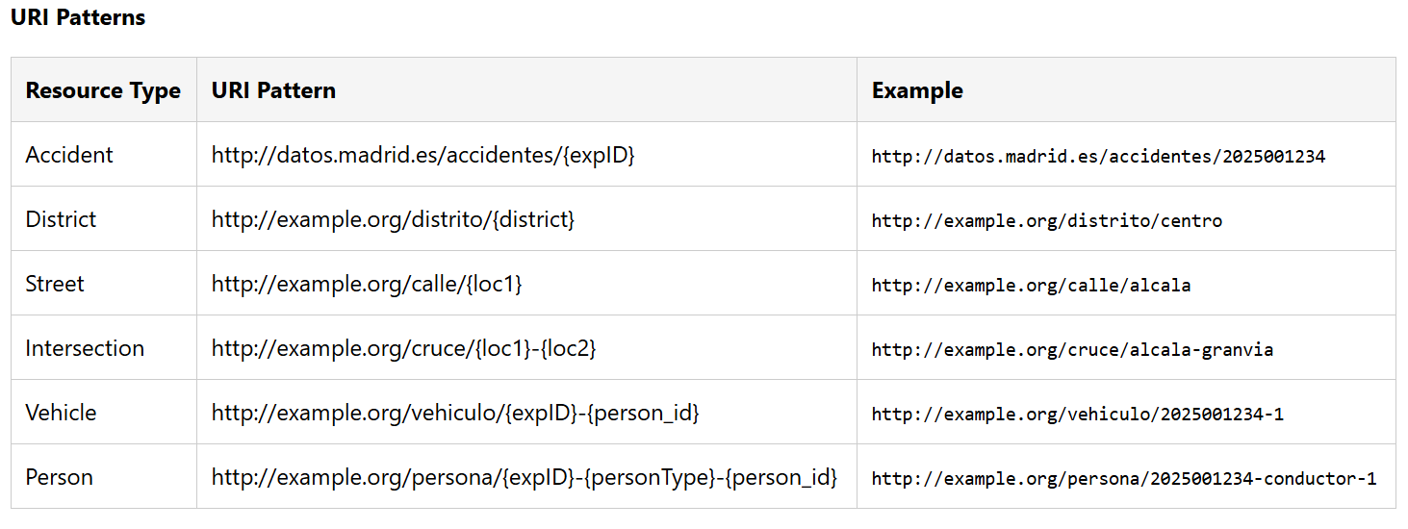
URIs

Slide 6
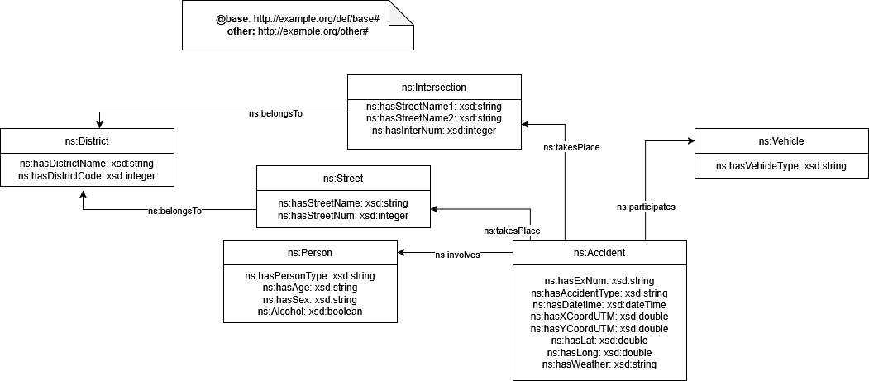
ONTOLOGY

Slide 7
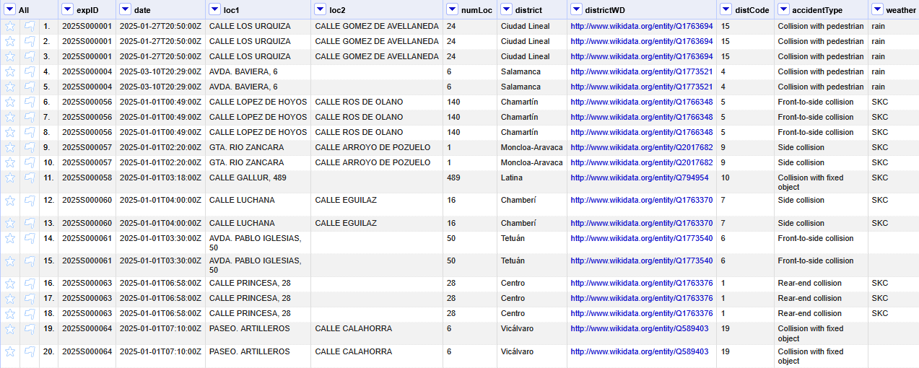
RECONCILED CSV

Slide 8
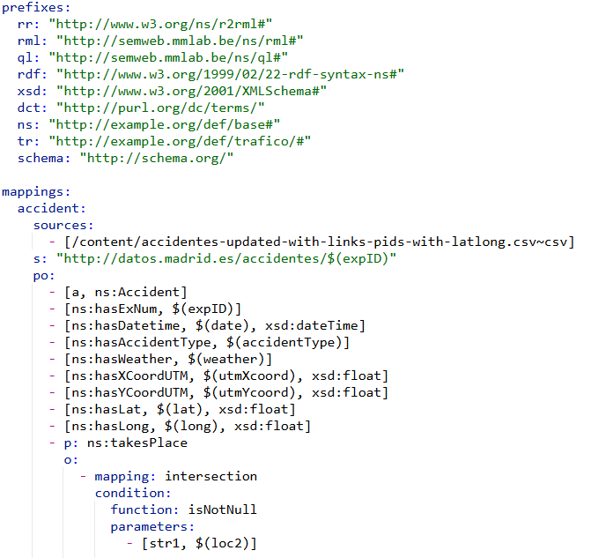
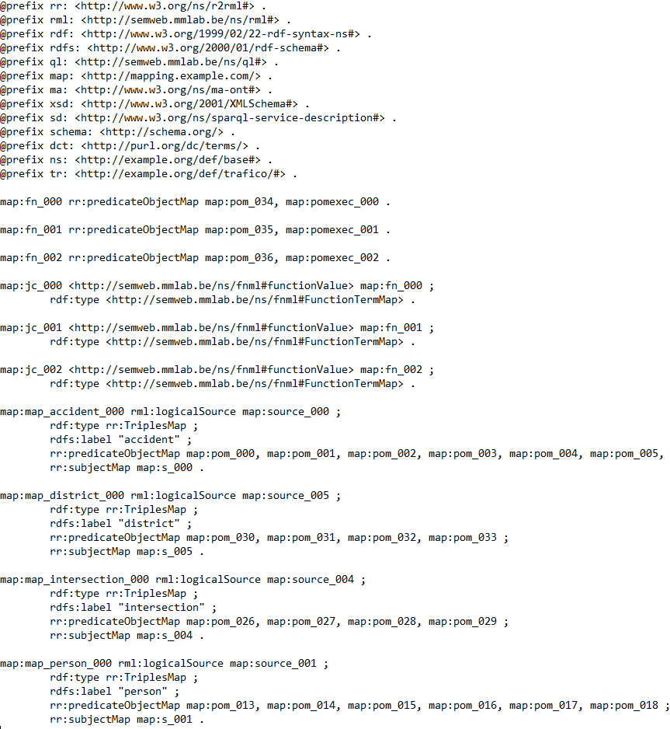
MAPPINGS

Slide 9
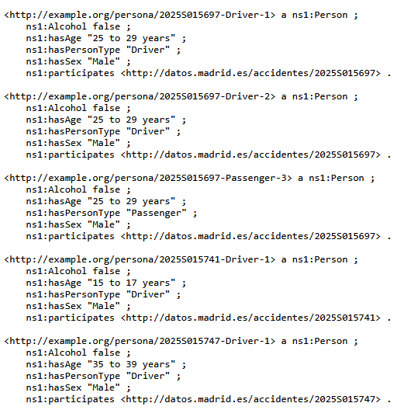
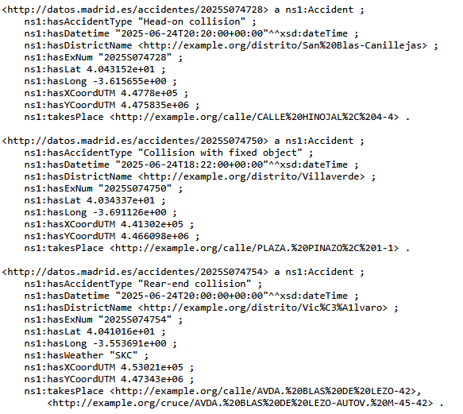
RDF

Slide 10

APP

